Slide 1
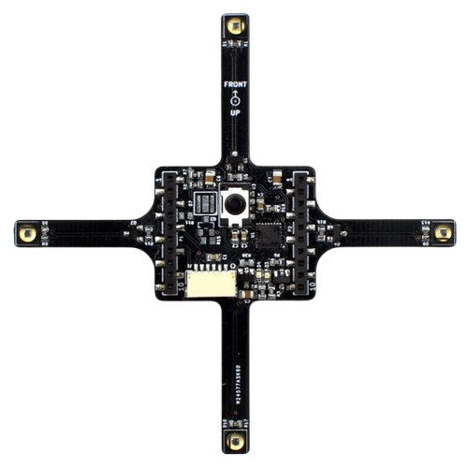
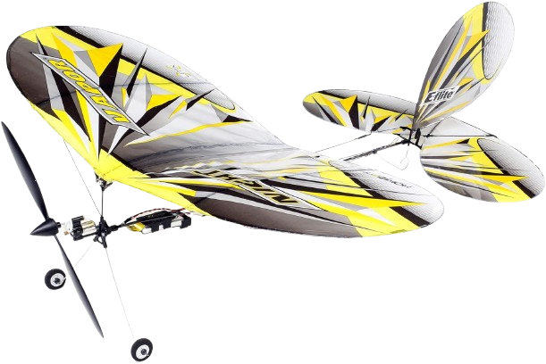
Guide for Assembly
of
Fixed-Wing Aircraft
Figure 1: UMX Night Vapor RC Plane
Figure 2: Bitcraze Active Marker Deckt
Parts List
1 UMX Night Vapor (Figure 1)
1 Bitcraze Active Marker Deck (Figure 2)
Tools List
3D Printer
Soldering Kit
Wire Cutters
Notes:
Windracers instructions:

Slide 2

UMX Night Vapor
Purchase a UMX
Night Vapor here:
Figure 1: UMX Night Vapor RC Plane
Or at this URL below:
https://www.horizonhobby.com/product/umx-night-vapor-rtf-with-as3x-and-safe-select/EFLU1300.html
Notes:
Windracers instructions:

Slide 3
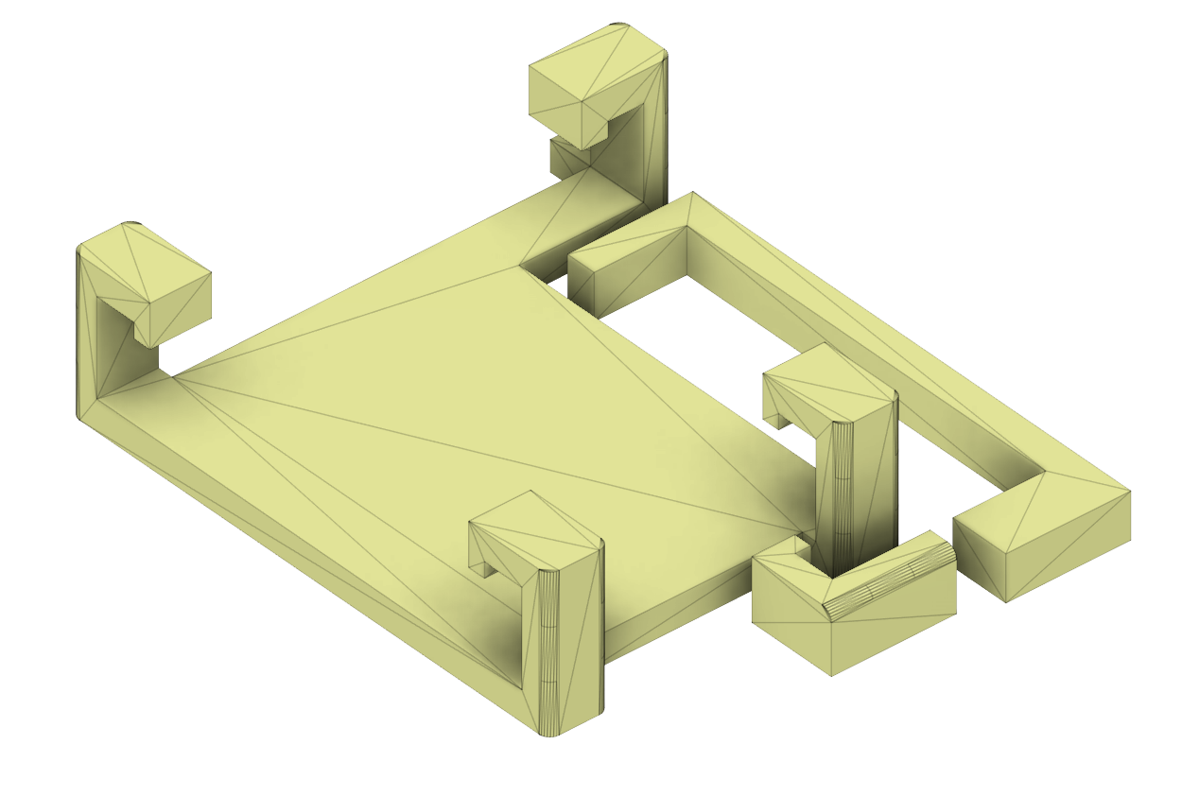
Bracket Specs & Assembly
The bracket was designed to stably affix the active marker board to the Night Vapor. The hooks on the main body of the bracket connect to the bracket for the main Night Vapor control board and the active marker board is secured underneath the active marker bracket. This ensures a sleek, aerodynamic profile.
Figure 1: 3D bracket schematic
Notes:
Windracers instructions:

Slide 4
Active Marker Board Modifications
Step 1: Gather 8 X inch long pieces of 30 AWG wire (preferably black for aesthetic purposes), strip X mm off the ends.
Step 2: Cut off the four arms of the board following the specified lines
Step 3: Solder the wires to the corresponding plates and markers
Step 4: Use electric taping / shrink to cover the wiring by heating
Figure 2: Bitcraze Active Marker Deckt
Notes:
Windracers instructions:

Slide 5
Active Marker Board Modifications
Step 1: Gather 8 X inch long pieces of 30 AWG wire (preferably black for aesthetic purposes), strip X mm off the ends.
Step 2: Cut off the four arms of the board following the specified lines
Step 3: Solder the wires to the corresponding plates and markers
Step 4: Use electric taping / shrink to cover the wiring by heating
Figure 2: Bitcraze Active Marker Deckt
Notes:
Windracers instructions:

Slide 6
Final
Assembly
text
Notes:
Windracers instructions:

Slide 7
How
To Fly
text
Notes:
Windracers instructions:

Slide 8
General steps (temp slide)
Get da parts
3D print this special little bracket thing that will go on the plane (3d file)
Solder + wire the active marker and its connections to both the plane and the battery
affix that thang

